Slide 1
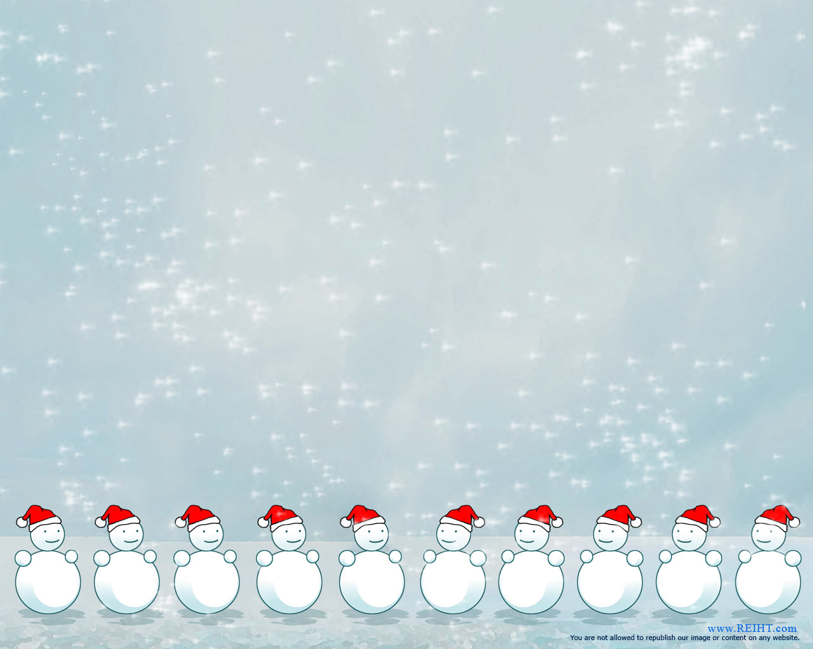
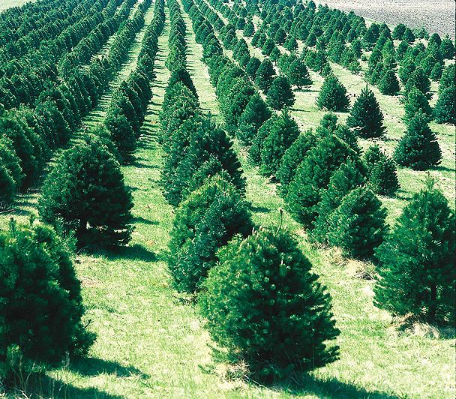
Merry MATHmas!
Ms. Barker runs a Christmas Tree Farm in the winter. She purchased 24 trees to plant. She needs help arranging the trees in equal rows and columns. What might her tree farm look like?

Slide 2
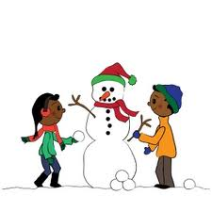
Merry MATHmas!
The snow has finally landed in Stockbridge, GA. The children are so excited to make snowmen. Each snowman must be made using three balls of snow. How many snowmen can you make if you rolled 34 balls of snow?

Slide 3
Merry MATHmas!
The stable door is closed and all you can see is legs under the door. If you see 20 legs, how many reindeer and elves could be in the stable?

Slide 4

Merry MATHmas!
Ms. Perry decided to make gingerbread cookies for all the teachers at SES. Each box holds 2 cookies. If there are 30 teachers at SES, how many boxes will she need to make?
What is a strategy that you could use to prove your thinking?

Slide 5

Merry MATHmas!
Ms. Wooden loves to hang candy canes around the house. On the first day, she hung 2 candy canes. On the second day, she hung 4 candy canes. On the third day, she hung 8 candy canes. How many candy canes will she hang on the 5th day?
Make a table to record your thinking.

Slide 6
Merry MATHmas!
The elf to the left is able to make 3 toys in 1 hour. How many toys will he make while you are at school for 8 hours today? Explain your thinking!

Slide 7
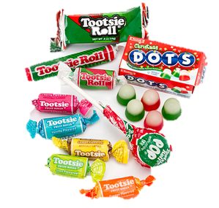
Merry MATHmas!
Ms. Henderson has 4 bags of candy. Each bag has 10 pieces. If she eats 4 pieces today, how much candy will be left?

Slide 8



Merry MATHmas!
Ms. Bostic hangs 10 red ornaments on the tree. She puts an equal amount of blue. Then she adds one row of 8 yellow ornaments at the bottom. What is the total number of ornaments on the tree. Prove your thinking.

Slide 9

Merry MATHmas!
Ms. Brown went shopping on Monday and bought 2 presents. On Tuesday she bought 2 presents and on Wednesday she bought 2 presents. If this pattern continued until Sunday, how many presents would Ms. Brown have to wrap on Sunday night?

Slide 10

Merry MATHmas!
Ms. Hawkins’ class built 7 snowmen during recess. Each snowman was built using 3 layers of snowballs. It takes 1 hour for the sun to melt one snowball on each snowman.
How long will it take for all the snowmen to melt?
Explain your thinking.

